Slide 1

Visualizing the Data: The impact of invasive species on native flora
By: Nick Romano, Jared Rosenberger, Kirin Sharma, and Ferdinand Yeke

Slide 2
Goals of Data Analysis
We will explore the data through the lens of attempting to identify whether and to what degree invasive species affect native flora throughout the Olmsted Parks Conservancy.
This issue is of great importance to our community partners, as they are constantly attempting to minimize this impact on native species and protect local biodiversity.
By further investigating these impacts and helping to understand areas of concern, we can help identify and prioritize where attention should be given.

Slide 3
Data Overview
The data being investigated is from 2022InvasiveSurvey, and includes the following parks:
Cherokee Park
Seminary Park
Seneca Park
Shawnee Park
Key variables in dataset:
Canopy – the most common species observed in the canopy
Understory – the most common species observed in the understory
Presence of Invasive Species – indicator of whether an invasive species was observed in a trimble station, and how prominent it was
Iroqouis Park
Bingham Park
Chickasaw Park
Tyler Park

Slide 4
Initial Observations
There were 454 separate Trimble stations with complete data throughout the parks of focus.
There were a total of 215 unique species observed in the canopy and understory data throughout all Trimble stations.
There were 15 invasive species focused on throughout the data which were categorized based on their respective coverage of area.
The most commonly observed were Euonymus fortunei or winter creeper, and Lonicera maackii or honeysuckle.

Slide 5
Data Cleaning Process
Initially, we cleaned the canopy and understory species columns in Excel for each of the parks in the 2022InvasiveSurvey Excel file due to inconsistencies.
While cleaning the data in Excel, we identified Trimble stations that were scratched and didn’t have any data; these were dropped in python.
There were a few missing values in 3 or 4 of the invasive species columns. We assumed that if an invasive species record was left blank then the invasive species was not present.

Slide 6
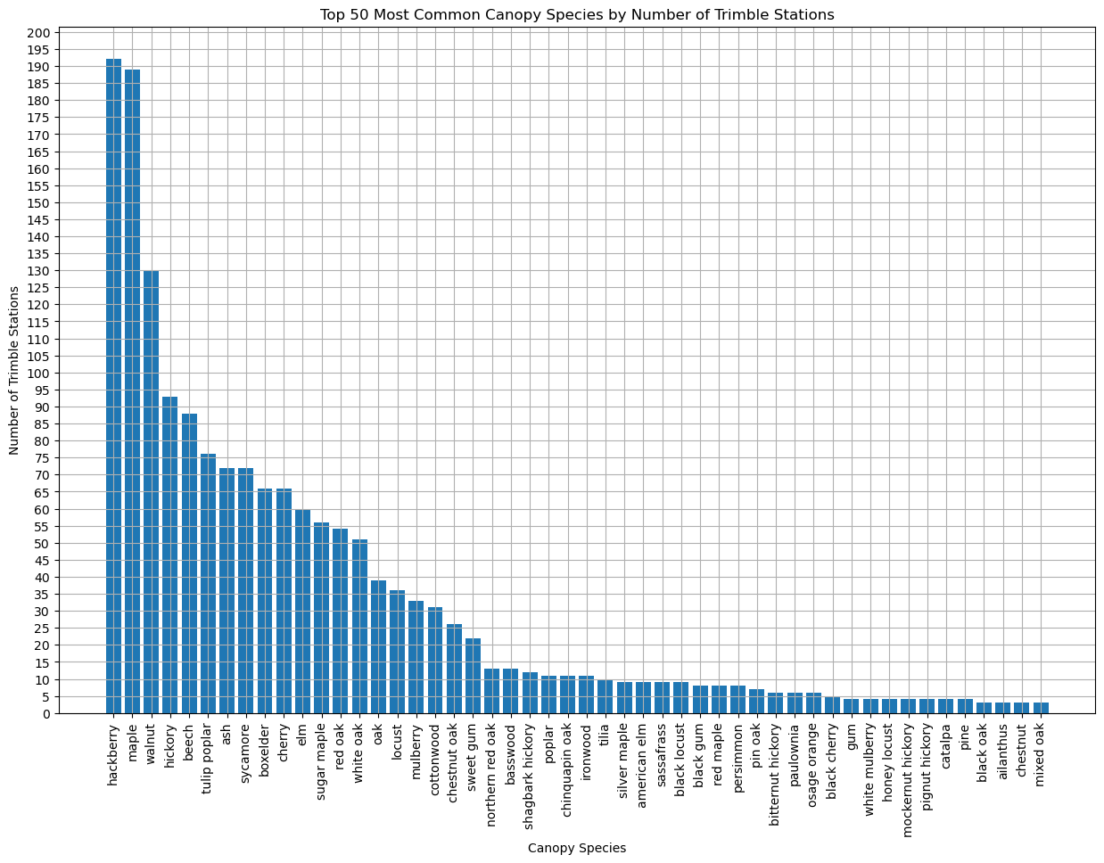
Most Common Canopy Species

Slide 7
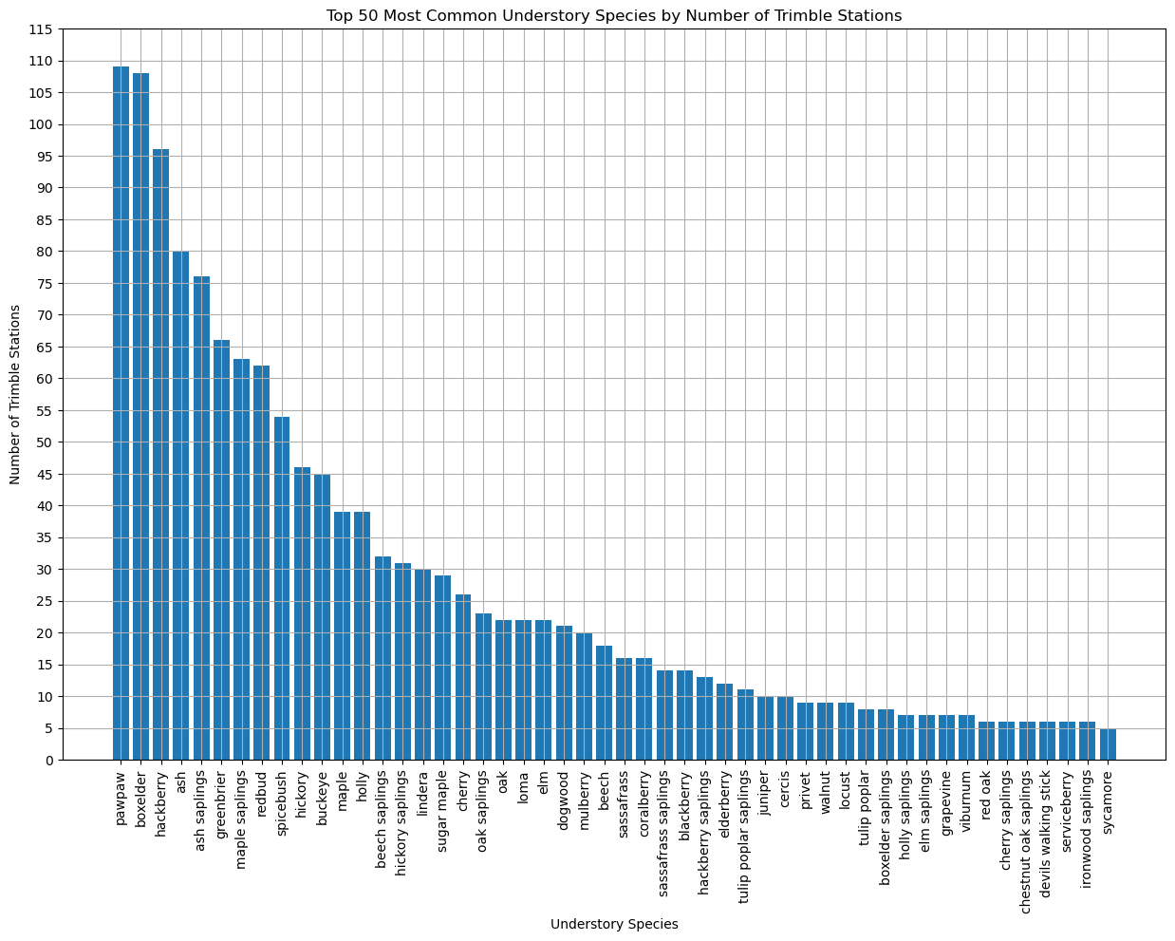
Most Common Understory Species

Slide 8
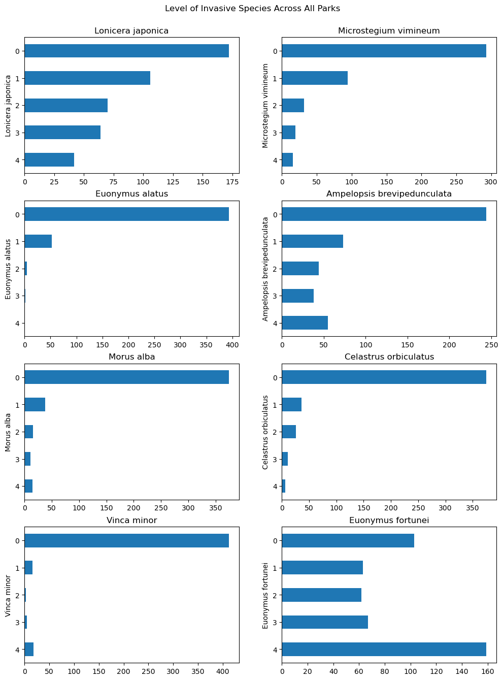
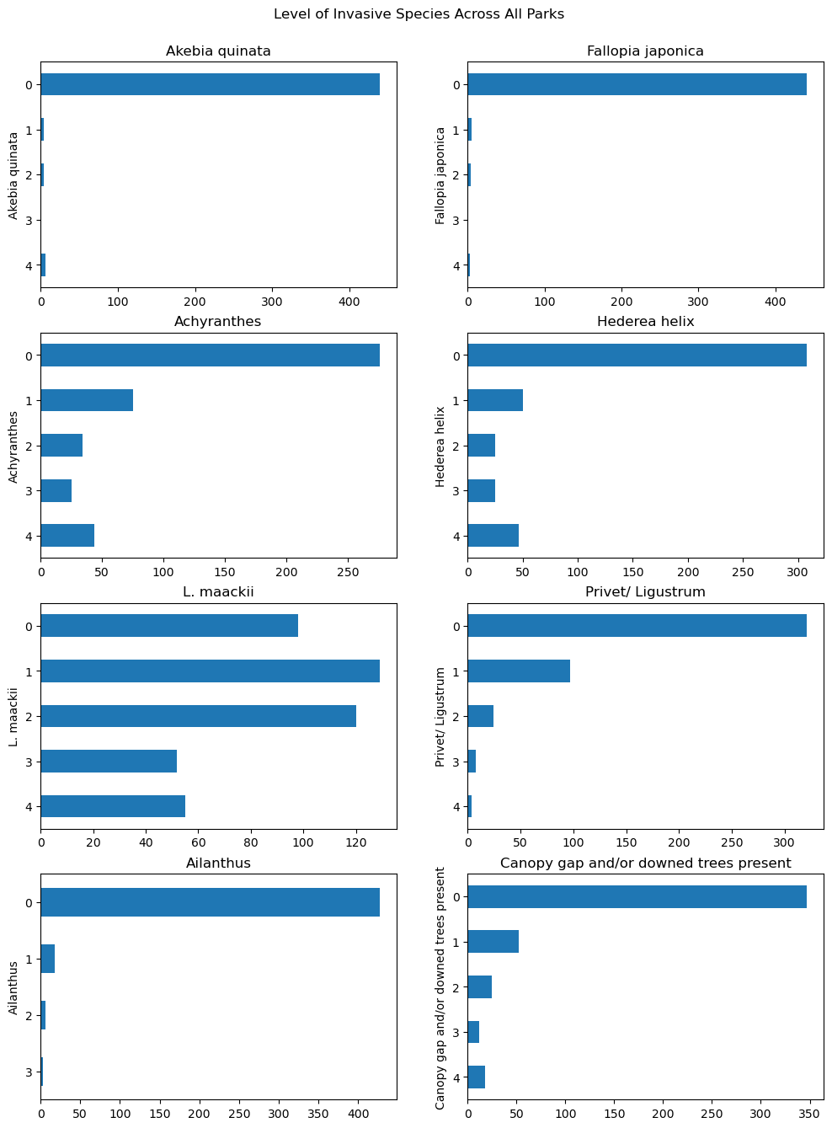
Levels of Invasive Species Presence

Slide 9
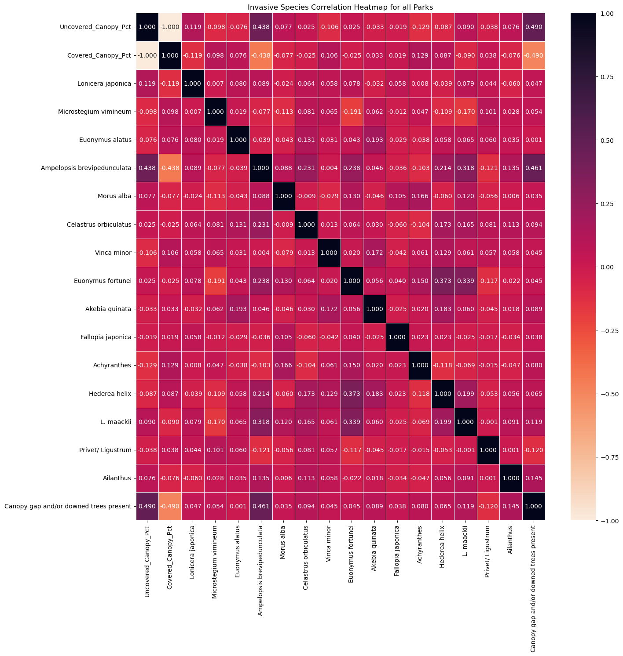
Invasive Species Heatmap

Slide 10
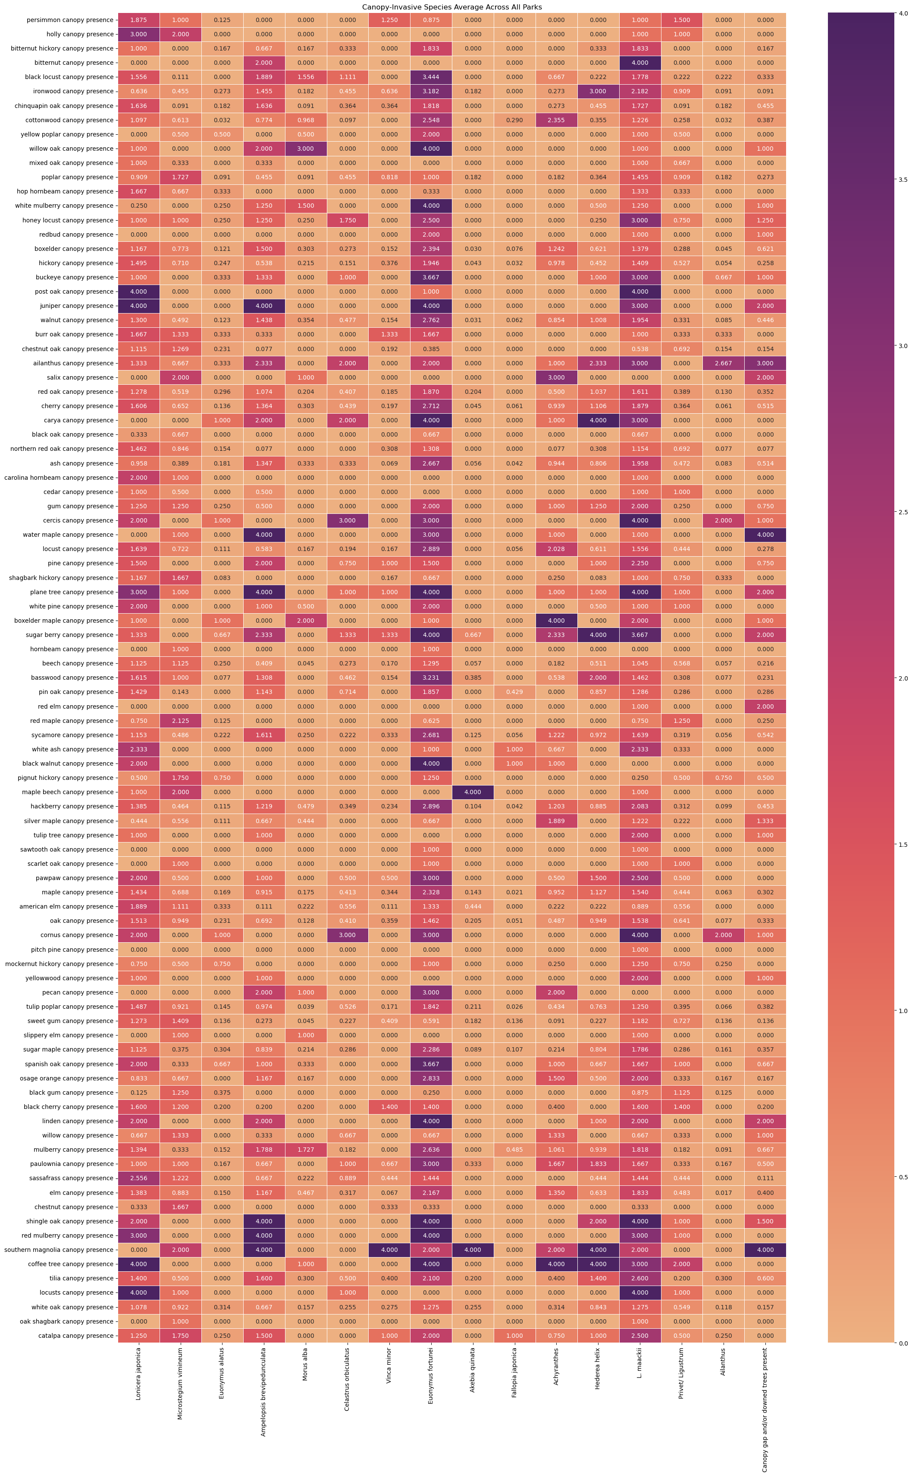
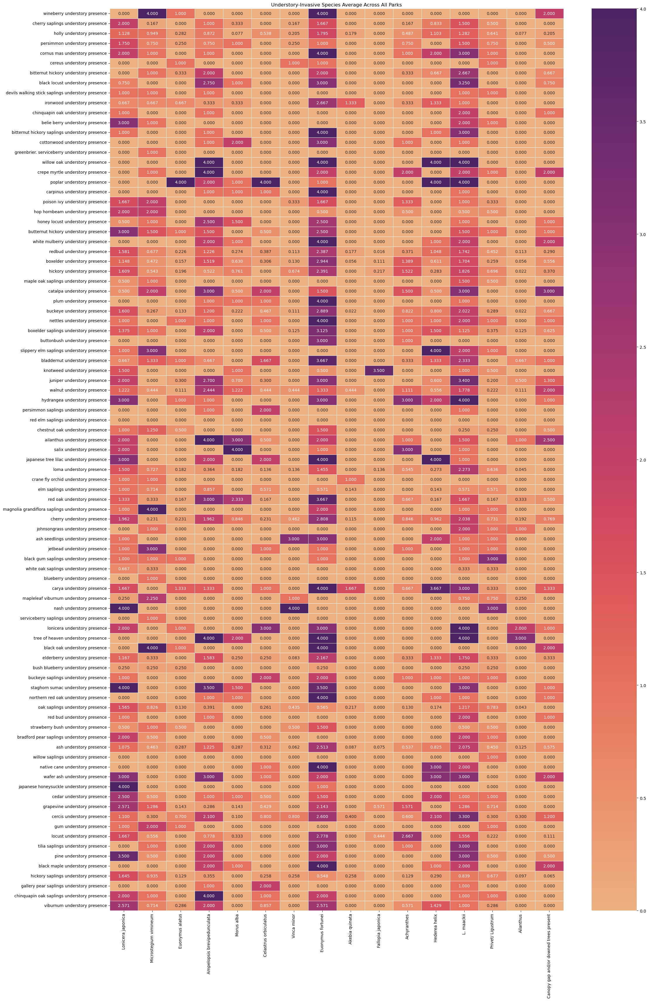
Average Invasive Species Presence Heatmap

Slide 11
Key Insights
Most common species:
Canopy: hackberry, maple, walnut, hickory, beech, tulip poplar, and sycamore [70+ trimble stations across all parks]
Understory: pawpaw, boxelder, hackberry, ash, ash saplings, and greenbrier [65+ trimble stations across all parks]
Invasive: Most invasive species have no presence or less than 5% of a trimble station area. However, Euonymus fortunei, L. Maacki, Hedread Helix, Ampelopsis brevipedunculata do see increases in 5-25% and 25%+ coverage.
Invasive Species Correlation

Slide 12
Next Steps
Continued investigation of the trends uncovered in this data set.
Clean, process, and analyze the 2024 data set.
Preform a comparative analysis on the two data sets to see the effects of these invasive species on native populations over time.
We will build a model that can identify and predict the populations and presence of species given external factors.

Slide 13
Thank You!

